Slide 1
Content-centric Networking (CCN)
Group 1

Slide 2
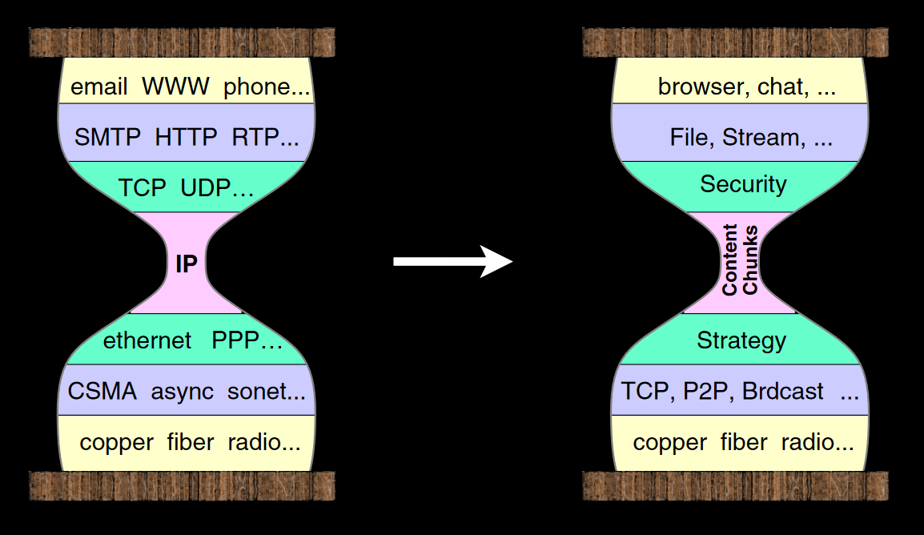
General structure
Jacobson et al., 2007

Slide 3
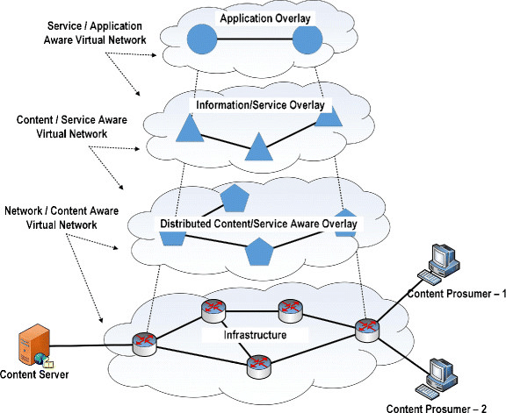
General structure
Mundugar, 2017

Slide 4
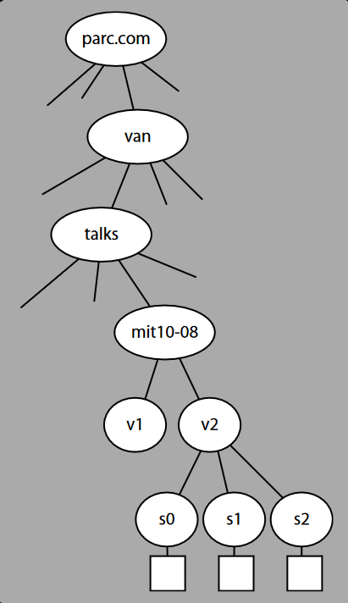
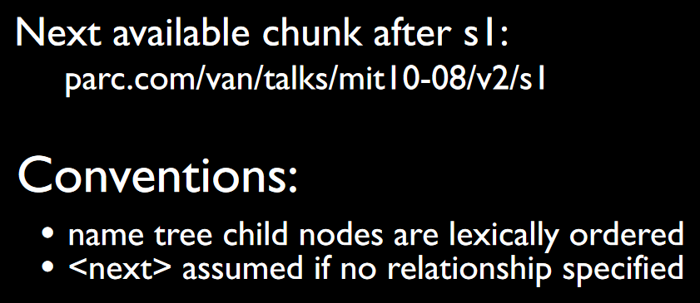
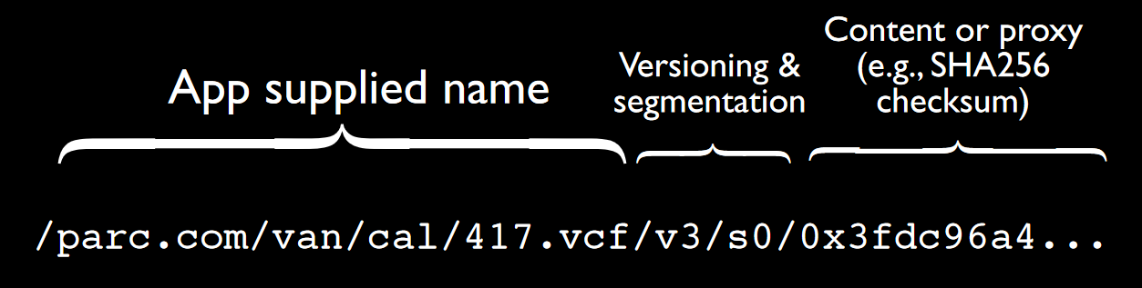
Hierarchical structure
→ Like NDN (Named Data Networking), CCN uses this type of forwarding, which counteracts the limited availability of IPv4.
Jacobson et al., 2007,
Ding et al., 2016

Slide 5
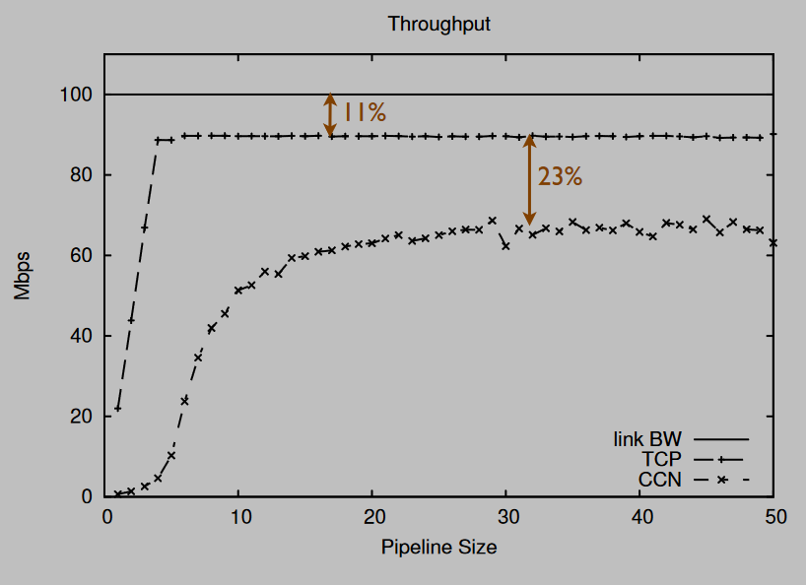
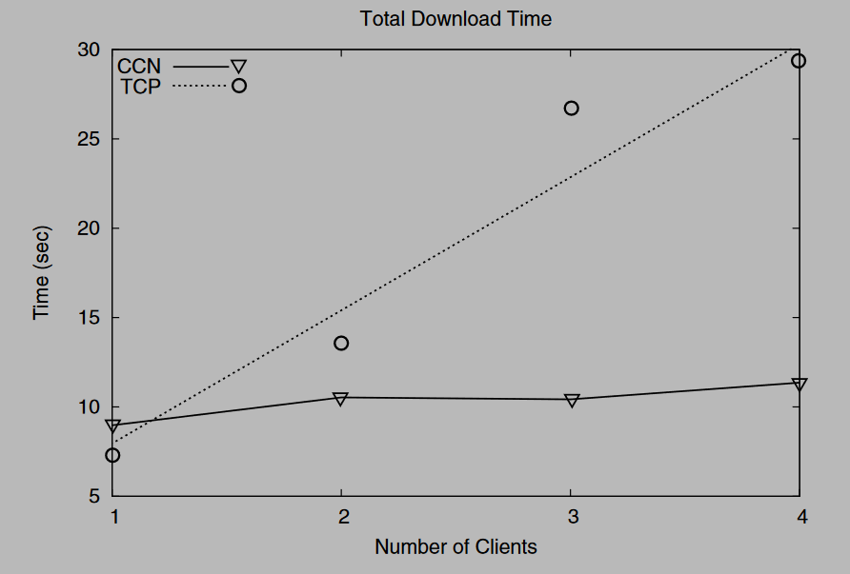
Advantages compared to IP
Bulk-data transfer performance comparison
Shared-content performance comparison
Jacobson et al., 2007

Slide 6
Beneficial approaches
Security: secure data not communication pipe
Ensure data trust.
Guarantees data integrity.
Enables verification on data provenance.
Flexibility: use names to communicate not IP addresses
CCN Names identify an information collection (not an information container)
Name hierarchy indicates membership
Same information can have many names
Scalability: alows caching, multicast traffic, load balancing, resource planning
CCN and NDN allows data packets to be cached in the router‘s CS (Content Store)
Forwards packets based on names rather than addresses (IP address exhaustion)
Ding et al., 2016,
Gür, 2015

Slide 7
References:
Ding, W., Yan, Z. & Deng, R. (2016) A Survey on Future Internet Security Architectures. IEEE Access. 4: 4374-7393. Available from: https://0-ieeexplore-ieee-org.serlib0.essex.ac.uk/document/7526334#IEEE [Accessed 13 February 2022].
Jacobson, V., Mosko, M., Smetters, D., & Garcia-Luna-Aceves, J. (2007). Content-centric networking. Whitepaper, Palo Alto Research Center, 2-4. Available from: http://bnrg.cs.berkeley.edu/~randy/Courses/CS294.S13/14.2b.pdf [Accessed 14 February 2022].
Gür, G. (2015) Modeling and Simulation of Computer Networks and Systems. Science Direct. Available from: https://www.sciencedirect.com/topics/computer-science/centric-content [Accessed 15 February 2022].
Mundugar, R. (2017) Future Content Centric Internet Architecture. ResearchGate. Available from: https://www.researchgate.net/figure/Future-Content-Centric-Internet-Architecture-29_fig1_309358763 [Accessed 16 February 2022].

